Slide 1
Introduction to the HTML Template Language
Objectives:
Explain HTL
Explain the goals of HTL
Explain the HTL syntax
Render the page content by using Adobe Experience Manager (AEM) global objects
Render page content by using HTL attributes
Notes:
Note to CDs: Ensure the font used for Objectives is Adobe Clean SemiLight; Pt 18.

Slide 2
HTML Template Language (HTL)
Recommended language for developing components
HTML presentation along with dynamic values added by business logic and global objects
Features:
Valid HTML5
Secure by Default
Separation of concerns
Compatible with JSP
Notes:
HTL (HTML Template Language) was formerly known as Sightly. Starting in AEM 6.2, the name was changed to HTL.
May want to point out that this course is NOT an HTL course, and that there are numerous documentation materials and tutorials available online for you to learn HTL on its own. Point out that HTL is fairly easy to learn and adopt. If you know HTML, you can learn HTL very rapidly.
Also recall that We.Retail is completely utilizing HTL components.

Slide 3
HTL: Advantages
Simplified Development
Security
Reduced Cost and Effort
Less code
Cleaner code
More intuitive code
Efficient
Separation of concerns
Web designer versus web developer
Cross-site scripting protection
Built-in
Automatic
Context-sensitive
Link externalization
Reduced effort
Faster Time To Market (TTM)
Lower Total Cost of Ownership (TCO)
Notes:
• Provide increased security through automated and context-sensitive cross-site scripting protection.
• Simplify development by helping HTML developers to write more intuitive and efficient code.
• Reduce cost through reduced effort, faster Time To Market (TTM), and lower Total Cost of Ownership (TCO).

Slide 4
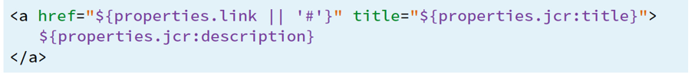
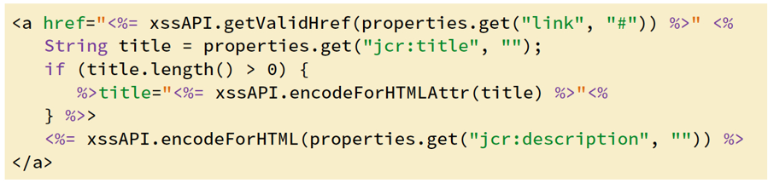
HTL versus JSP: Example
HTL (less code, more secure)
JSP (more code, less secure)

Slide 5
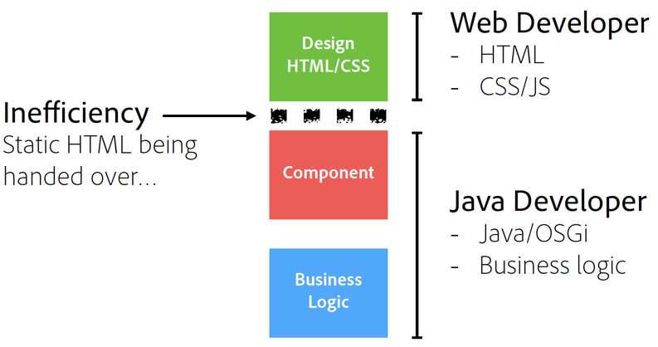
Implications of Using HTL: Inefficiencies of JSP
JSP development workflow

Slide 6
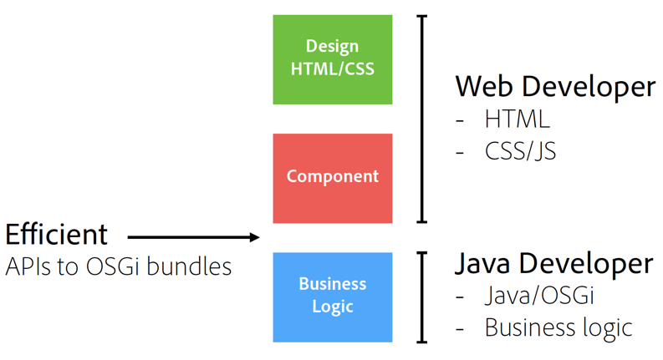
Implications of Using HTL: Efficiencies of HTL
HTL development workflow
Notes:
HTL is preferred by Adobe due to its simplicity and advantages.

Slide 7
HTML Syntax
Two types of syntaxes:
HTL Block Statements
HTL Expressions
These statements define structural elements within the template.
Runtime creates the final HTML.
All HTL-specific attributes are prefixed with data-sly-
Expressions are delimited by characters ${ and }.
At runtime, these expressions are evaluated and their value is injected into the outgoing HTML stream.
Expressions can occur within the HTML or within the attribute values.

Slide 8
Basic HTL Tags and Examples
Comments— <!--/* An HTL Comment */-->
URI Customization— ${‘example.com/path/page.html’ @ scheme=’http’}
Resulting Output: http://example.com/path/page.html
Block Statements
use: <div data-sly-use.nav=”navigation.js”>${nav.foo}</div>
list: <dl data-sly-list=”${currentPage.listChildren}”>
Special HTML tag: <sly>
Notes:
HTL comments are HTML comments with additional syntax. They are delimited like shown here.

Slide 9
Expressions
Two types:
Literals
Boolean: ${true} ${false}
Strings: ${'foo'} ${"answer"}
Positive integers: ${42}
Arrays: ${[42, true, 'Hello World’]}
Variables
Local HTL variables: ${myVarInHTL}
Global Java object methods: ${currentPage.title}
Object variables from Business logic: ${myObj.myVar}

Slide 10
Global Objects for HTL
Enumerable objects can be iterated through using data-sly-list.
properties
pageProperties
inheritedPageProperties
Java-backed objects
component – componentContext
currentDesign
currentPage
currentSession
request - response
resource – resourceDesign – resourcePage
wcmmode

Slide 11
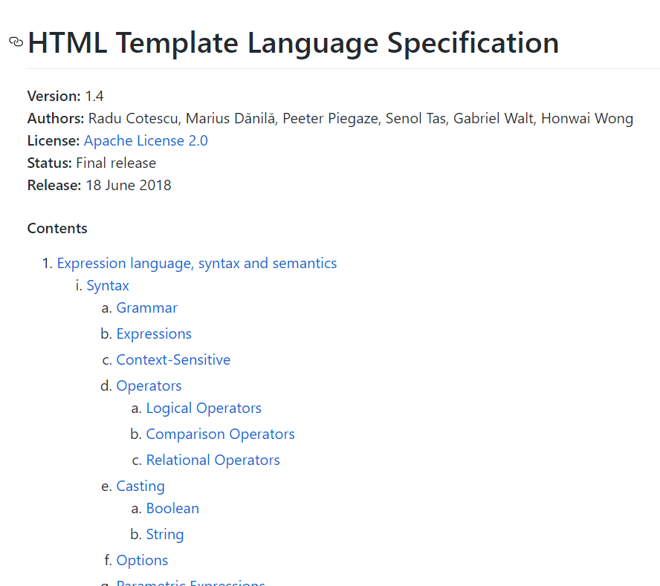
HTL Specification
The HTML Template Language specification GitHub repository for HTL attributes, behavior, and syntax: https://github.com/adobe/htl-spec
Notes:
Demonstrate this page:
https://github.com/Adobe-Marketing-Cloud/htl-spec/blob/master/SPECIFICATION.md

Slide 12

Select the three correct statements about HTL.
A template created in HTL is a valid HTML5 file.
HTL is not compatible with JSP or ESP.
HTL is the recommended language for developing components in AEM.
You cannot include HTL expressions within HTML tags.
HTL automatically filters and escapes all text being output to the presentation layer to prevent cross-site-scripting vulnerabilities.
Notes:
Correct Answers: A, C, E

Slide 13
Exercise 1: Render page content by using AEM global objects
Exercise 2: Render page content by using HTL attributes

Slide 14
HTL is the recommended language for developing components in AEM.
The advantages of HTL include simplified development, security, and reduced cost.
HTL has two different types of syntaxes, Block Statements and Expressions.

Slide 15
Which of the following describes the functionality of data-sly-include attribute? Select the correct answer.
Add a component to the current script.
Include a script file in the current script at rendering time.
Include a script file in the current script at compile time.
Include a template in the current script.
Notes:
Answer: B

